Slide 1
CS 5180 Final Project Warehouse Robot Path Planning with Proximal Policy Optimization
Presented by
Kevin Sani, Pratik Baldota

Slide 2
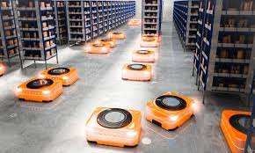
Project Problem
Warehouse Robot Path Planning with PPO
Optimize warehouse operations using three reinforcement learning algorithms – PPO, SAC, and DQN. Evaluate based on reward maximization and implementation ease to identify the most efficient algorithm for enhancing overall logistics and operational processes in a warehouse.
Algorithms-
1) PPO
2) SAC
3)DQN

Slide 3
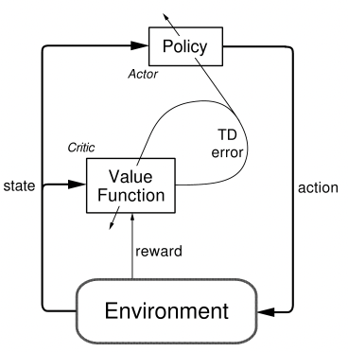
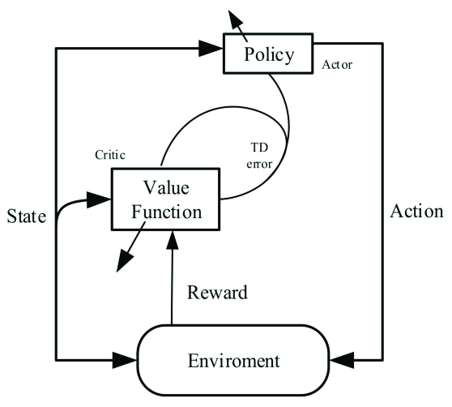
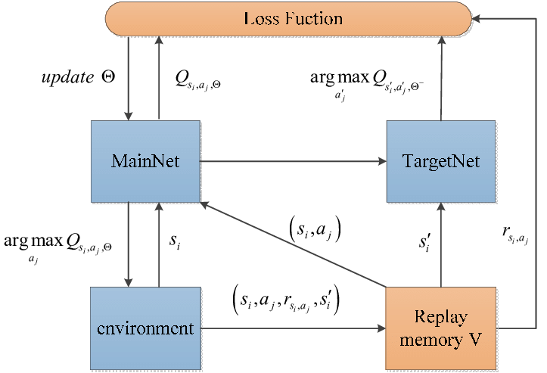
Project Approach/Algorithms
PPO(Proximal Policy Optimization)
Proximal Policy Optimization (PPO) is an algorithm in the field of reinforcement learning that trains a computer agent's decision function to accomplish difficult tasks.
DQN(Deep Q-network)
A DQN agent is a value-based reinforcement learning agent that trains a critic to estimate discounted expected cumulative long-term reward. DQN is a variant of Q-learning.
SAC(soft actor-critic)
The soft actor-critic (SAC) algorithm is a model-free, online, off-policy, actor-critic reinforcement learning method. The SAC algorithm computes an optimal policy that maximizes both the long-term expected reward and the entropy of the policy. The policy entropy is a measure of policy uncertainty given the state.

Slide 4
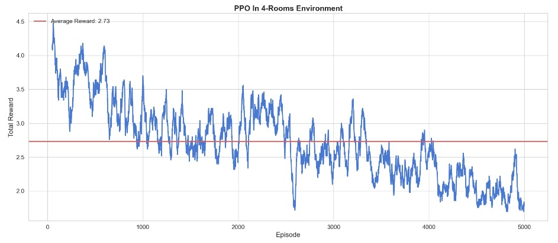
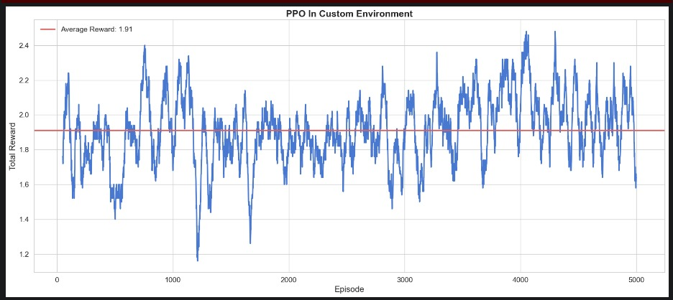
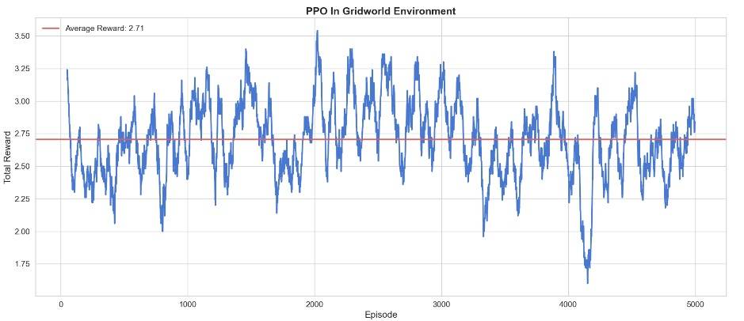
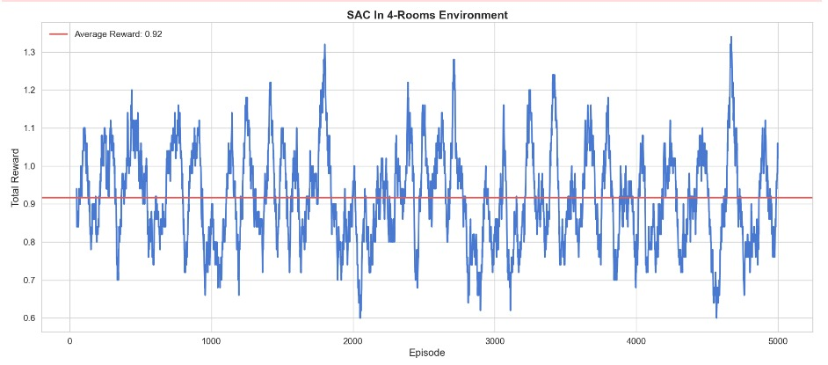
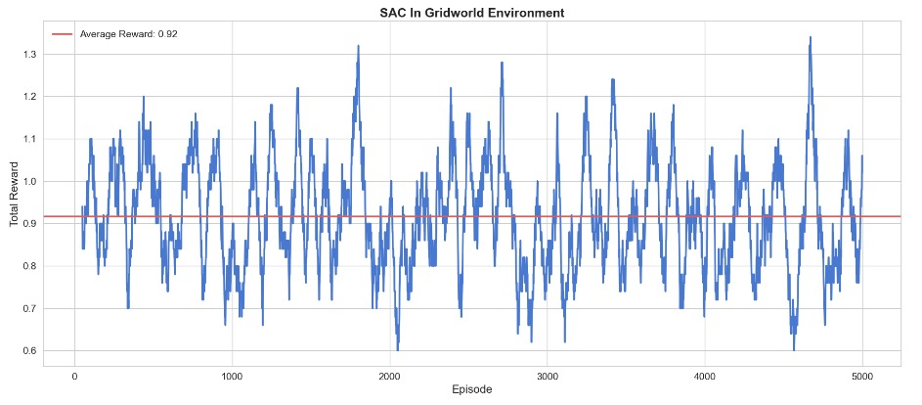
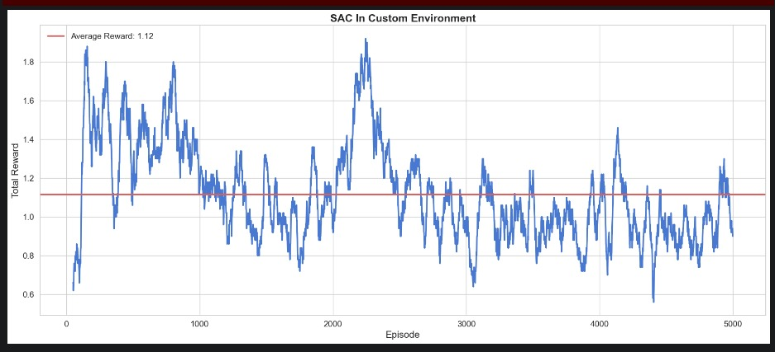
Project Experiments/comparisons/results
Results-
PPO Policy
SAC Policy-

Slide 5
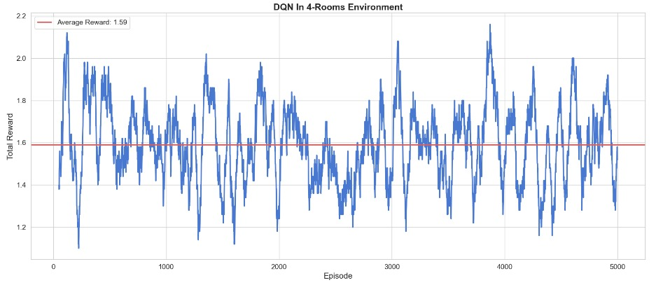
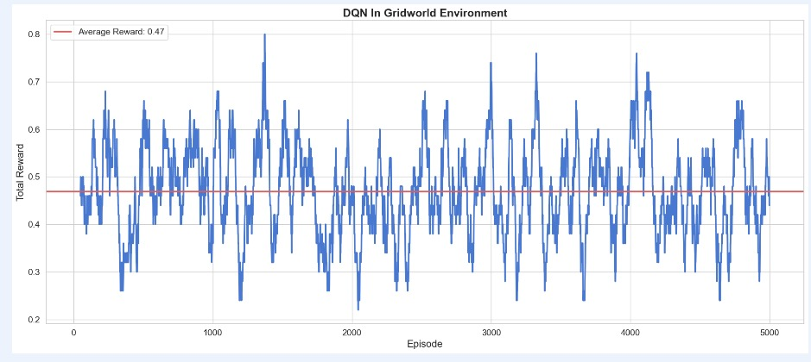
Project Experiments/comparisons/results
Results-
DQN Policy
CONCLUSION-
In summary, our implementation and evaluation of PPO, SAC, and DQN highlight PPO as the optimal choice. It consistently outperformed in terms of reward output and proved to be easier to implement compared to SAC and DQN. The combination of PPO's effectiveness and simplicity makes it the preferred algorithm for a wide range of reinforcement learning applications.

Slide 6
THANK YOU

